Slide 1

Why No Booster? Finding predictors to determine why people do not get the booster
By: Bilal Mukhtar

Slide 2
Goal
To discover predictors that help understand why those who received the vaccine chose not to get the booster

Slide 3
Context
As of right now, boosters are widely available for adults throughout the country
However, many still choose not to receive these boosters, even if they chose not to get the vaccine

Slide 4
Process
I looked at the 3 main reasons why people do not get the booster
Then I tried to find the major predictors that lead to these reasons

Slide 5
Data
All data was sourced from the Household Pulse Survey (HPS) Week 46 release

Slide 6
Goal Formation
The goal came about from analyzing previous visualizations that showed the major reasons people chose not to get the booster

Slide 7
Previous Visualization
The following graph shows the most common reasons for not getting the booster

Slide 8
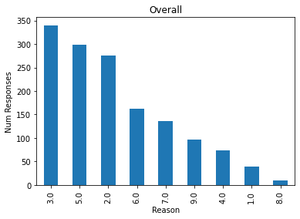
Reasons Graph

Slide 9
Reasons for no Booster
2: Plan to get booster
3: Booster is unnecessary
5: Already had COVID

Slide 10
Data Cleaning
All variables that were continuous values were removed
Then any variable with over 80% null values were removed
Lastly, NA values were imputed using the mean

Slide 11
Variable Selection
Forward selection was used for variable selection
Models were created for Reasons 2 and 3
No model was created for Reason 5

Slide 12
Reason 5 Correlation
Due to reason 5 being “Already had COVID”, any variable that also required having COVID was automatically a good predictor
As such, these variables were removed from the set of possible predictors before variable selection

Slide 13
Modeling
Each reason was split up for modeling with separate models being created due to separate variables being used
Training and testing data sets were created, then confusion matrices and importance graphs were created from the models
Bagging was used for making each model

Slide 14
Reason 2 / Plan to get booster

Slide 15
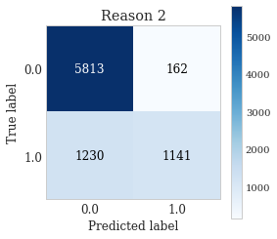
Training Confusion Matrix

Slide 16
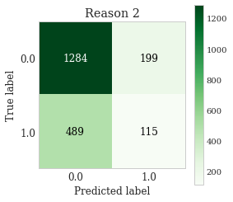
Testing Confusion Matrix

Slide 17
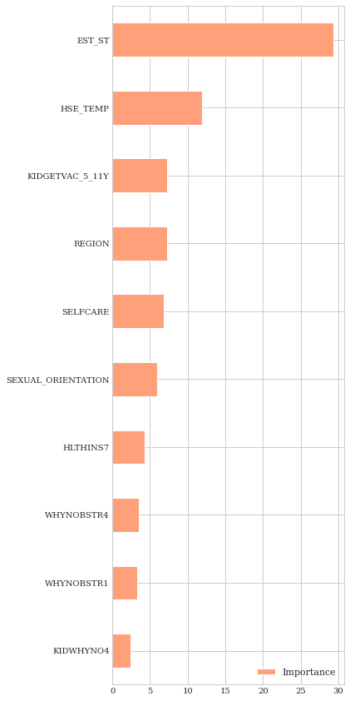
Variable Importance Graph

Slide 18
Stats
Accuracy for the model was 83% on training data and 67% on test data
EST_ST was clearly the most import variable and HSE_TEMP was a far second, with all other variables being unimportant

Slide 19
Variable Importance
EST_ST: The state someone is from
HSE_TEMP: Household was kept at an unsafe temperature due to cost

Slide 20
Variable Interpretation
The biggest determinate for someone planning to get the booster appears to be state
HSE_TEMP probably tells very little, except that these states may be poorer states

Slide 21
EST_ST analysis
After looking at the most common states, the top 3 are Texas, California, and Florida
Being the 3 most populous states, it appears there is very little actual information that can be gathered from using the state someone is from

Slide 22
Reason 3 / Booster is unnecessary

Slide 23
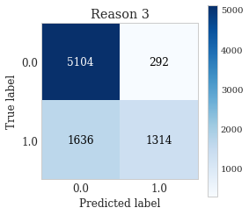
Training Confusion Matrix

Slide 24
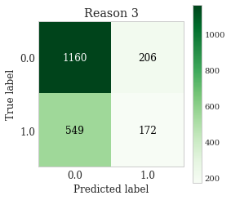
Testing Confusion Matrix

Slide 25
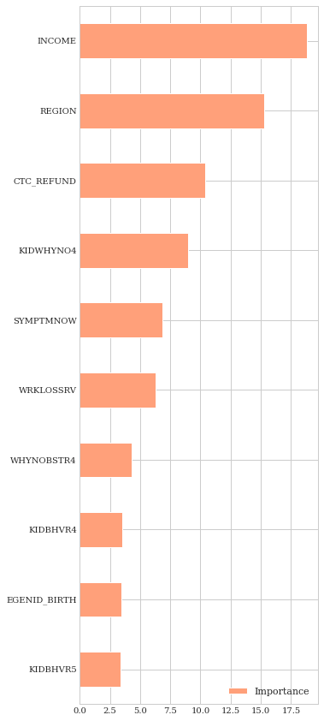
Variable Importance Graph

Slide 26
Stats
Accuracy for the model was 77% on training data and 64% on test data
INCOME, REGION, CTC_REFUND, and KIDWHYNO4 appear to be the most important variables, but there are multiple other variables with some level of importance

Slide 27
Variable Importance
INCOME: Income in the past year
REGION: Northeast, South, Midwest, or West of US
CTC_REFUND: Received a tax refund
KIDWHYNO4: Do not believe children need COVID vaccine

Slide 28
Variable Interpretation
Using INCOME and REGION, these are probably people from a specific region and specific income
CTC_REFUND probably has very little actual impact
KIDWHYNO4 is the most obvious candidate, as someone who does not want to get the booster probably would not want their kid getting the vaccine

Slide 29
Income/Region analysis
In terms of income, the most common were between $50,000 to $150,000 which shows about middle class
The region was more telling, with most people being from the South, which is a region that is known to be anti-vaccine/booster

Slide 30
Reason 5 / Already had COVID

Slide 31
Training Data Issue
Although I thought I removed any variables that were interacting, the training model still had 100% accuracy

Slide 32
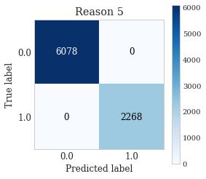
Training Confusion Matrix

Slide 33

Testing Confusion Matrix

Slide 34
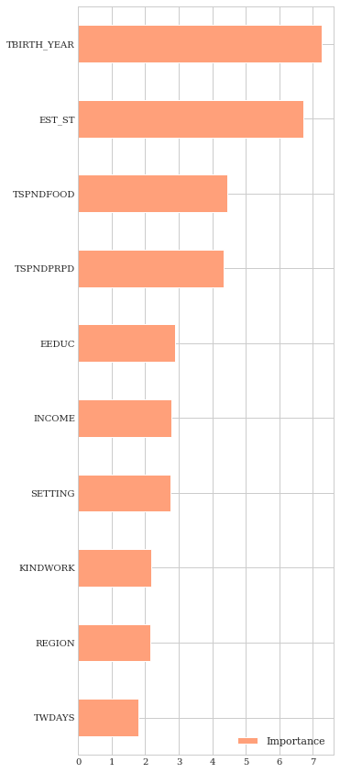
Variable Importance Graph

Slide 35
Stats
Accuracy for the model was 100%* on training data and 72% on test data
TBIRTHYEAR and EST_ST were the only predictors with any importance

Slide 36
Variable Importance
EST_ST: State person is from
TBIRTHYEAR: Year person was born

Slide 37
Variable Interpretation
Due to the overall low importance of the variables for this model, neither TBIRTHYEAR or EST_ST appear to show anything important

Slide 38
EST_ST/TBIRTH_YEAR analysis
EST_ST again just showed the most populous states
TBIRTH_YEAR showed the around age 40 in terms of year, which is a common age for those responding to the survey

Slide 39
Conclusions
Reasons 2 and 5 appear to have no significant variable to predict them
Reason 3, however, appears to have a couple variables that would also be indicative of someone from a conservative region/state

Slide 40
Future Application
Mainly for reason 3, the important predictors could be used to target campaigns to promote the booster
This could be done for the other reasons, although this may be ineffective

